Slide 1

Final Project web application
Detailed Developer Report

Slide 2
Security Status – Extremely Vulnerable
Hackers use SQL Injection to attempt to enter a precisely created SQL commands into a form field rather than the predictable information. The reason for this is to secure a response from the database that will enable the hacker to recognize the construction of the database, including table names.
XSS can allow untrusted users to execute code in the browser of trusted users and access some types of data, such as session cookies, an XSS vulnerability may allow an attacker to take data from users and dynamically include it in web pages and take control of a site or an application if an administrative
Using Brute Force Attack Hackers can crack passwords, login credentials, and encryption keys. It is a simple yet reliable tactic for gaining unauthorized access to individual accounts and organizations' systems and networks.
Using IDORs, an attacker can simply modify the filename to retrieve a transcript created by another user and potentially obtain user credentials and other sensitive data.

Slide 3
Vulnerability Statistics
Critical
16
Severe
7
Moderate
6
Low
6

Slide 4
Vulnerabilities:
No. | Severity | Vulnerability | Count
1 | Critical | SQL Injection | 3
2 | Severe | Reflected Cross Site Scripting | 1
3 | Severe | Stored Cross Site Scripting | 1
4 | Critical | Insecure Direct Object Reference | 3
5 | Critical | Rate Limiting Flaw | 1
6 | Critical | Insecure File Uploads | 1
7 | Moderate | Client Side Bypass Filter | 2
8 | Critical | Components with known Vulnerability | 3
9 | Critical | Default Admin Password | 1

Slide 5
Vulnerabilities:
No | Severity | Vulnerability | Count
10 | Low | Descriptive Error Messages | 1
11 | Low | Default Files Misconfiguration Flaw | 5
12 | Critical | Remote File Inclusion | 1
13 | Moderate | Directory Listing | 2
14 | Moderate | PII Leakage | 2
15 | Severe | Open Redirection | 1
16 | Severe | Bruteforce Exploitation | 1
17 | Critical | Command Execution Vulnerability | 2
18 | Severe | Force Browsing | 2

Slide 6
Vulnerabilities:
No. | Severity | Vulnerability | Count
19 | Critical | Seller Account Access | 1
20 | Severe | Cross Site Request Forgery | 1

Slide 7
1. SQL INJECTION
SQL Injection (Critical) | Below mentioned URL in the Shopping Website is vulnerable to SQL injection attack. Affected URL : http://65.2.179.27/products.php?cat=1 Affected Parameters : cat (GET parameter) Payload: cat=1’

Slide 8
1. SQL Injection
SQL Injection (Critical) | Here are some other SQLi Infected urls given below. Affected URL : http://65.2.179.27/products.php?cat=2 http://65.2.179.27/products.php?cat=3 Affected Parameters : cat (GET parameter) Payload: cat=2’ cat=3’

Slide 9
Observation
We add a single quote at the end of the url (In GET parameter)
http://65.2.179.27/products.php?cat=1’ and we found an sql error.

Slide 10
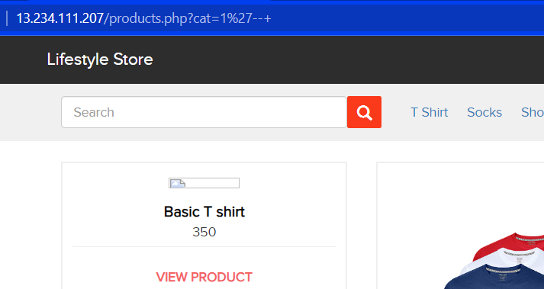
Observation
Now, we add --+ at the end of it. We can see that the error is removed.
http://65.2.179.27/products.php?cat=1’ --+

Slide 11
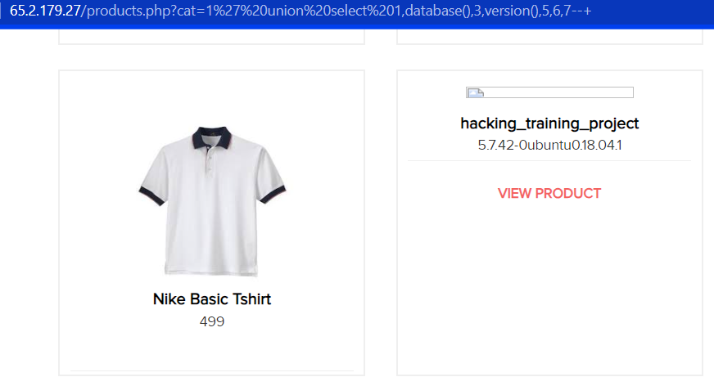
Proof of Concept (PoC)
Hackers can execute some sql commands given below. Using this commands hackers can view the name of the database and version being used.
http://65.2.179.27/products.php?cat=1%27%20union%20select%201,database(),3,version(),5,6,7--+

Slide 12
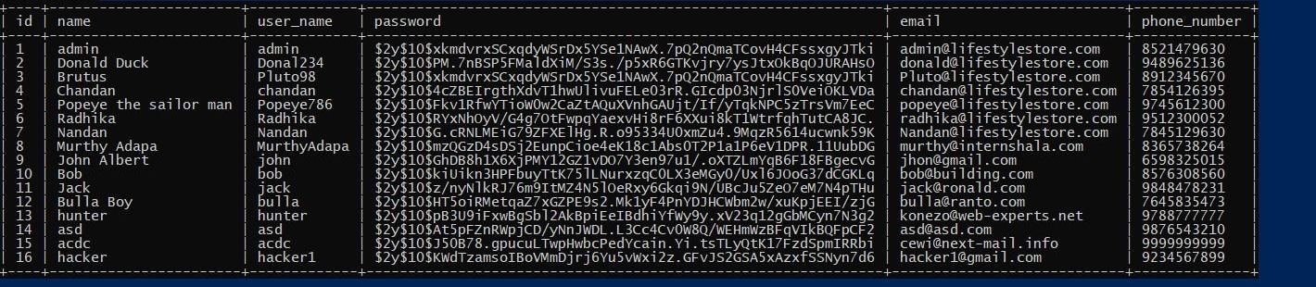
Business Impact – Extremely High
The SQL Injections in the Life Store Web Application are very dangerous as the attacker can gain complete access to the database.
Attacker can decrypt this hash passwords and gain access to customer’s, seller’s and as well as admin dashboard.

Slide 13
Recommendation
Primary Defenses:
Option 1: Use of Prepared Statements (with Parameterized Queries)
Option 2: Use of Properly Constructed Stored Procedures
Option 3: Allow-list Input Validation
Option 4: Escaping All User Supplied Input
Additional Defenses:
Also: Enforcing Least Privilege
Also: Performing Allow-list Input Validation as a Secondary Defense
Do not run Database Service as admin/root user
Disable/remove default accounts, passwords and databases

Slide 14
References
https://cheatsheetseries.owasp.org/cheatsheets/SQL_Injection_Prevention_Cheat_Sheet.html
https://cheatsheetseries.owasp.org/cheatsheets/Query_Parameterization_Cheat_Sheet.html

Slide 15
2. Reflected Cross Site Scripting (XSS)
Reflected XSS (Severe) | Below mentioned URL in the Shopping Website is vulnerable to XSS attack. Affected URL : http://43.204.30.166/search/search.php?q= Affected Parameters : q Payload: q=“<>

Slide 16
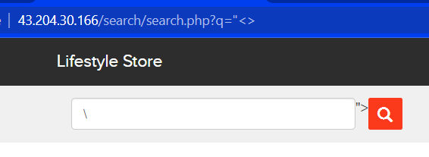
Observation
First LogIn to your account.
Then go to my cart and click on shop now option. Now, go to the search bar and type “<> at the end of url.
http://43.204.30.166/search/search.php?q=“<> . We will be able to see the code.

Slide 17
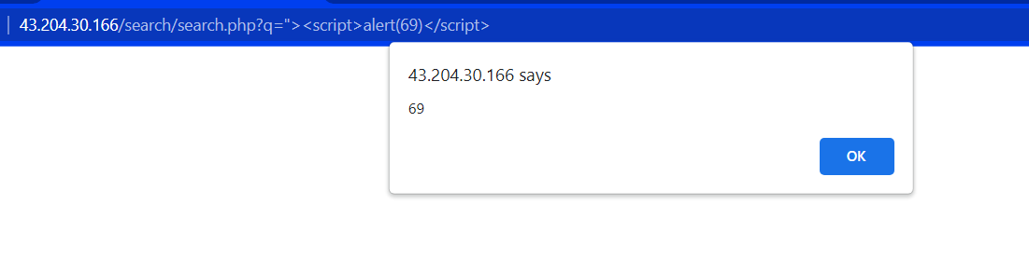
Proof of Concept (PoC)
Now, add this script in the url which can pop up an alert box.
http://43.204.30.166/search/search.php?q=“><script>alert(69)</script>

Slide 18
3. Stored Cross Site Scripting (XSS)
Stored XSS (Severe) | Below mentioned URL is vulnerable to stored XSS attack. Affected URL : http://43.204.30.166/products/details.php?p_id=22(all IDs) Affected Parameters : Customer Review Section Payload: <script>alert(69)</script>

Slide 19
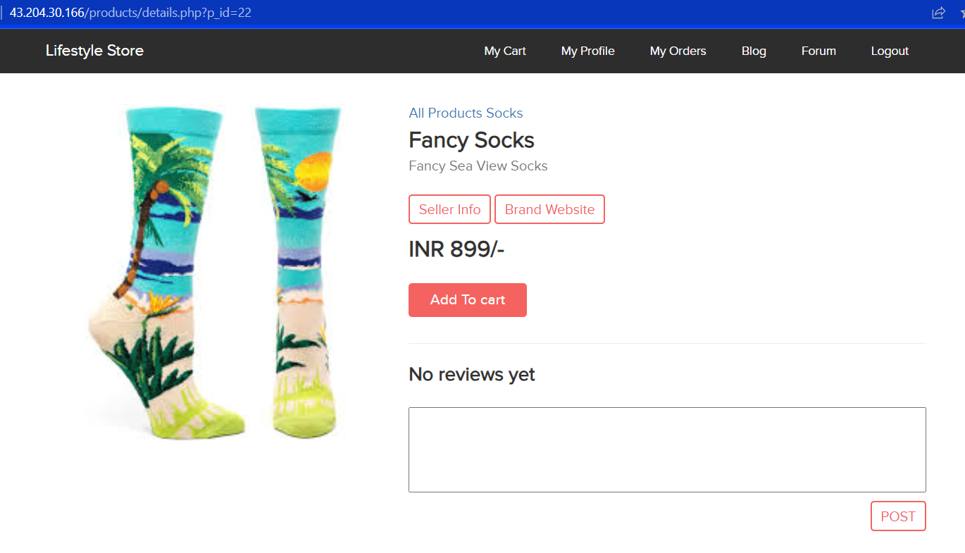
Observation
First navigate to the shopping section and then click on any product listed in the shopping section.
You will find a product review comment box below for every product.

Slide 20
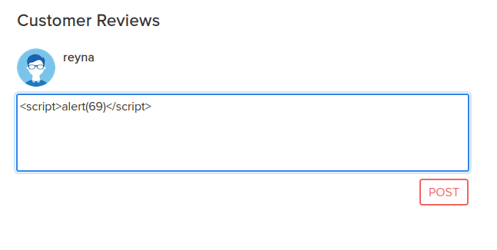
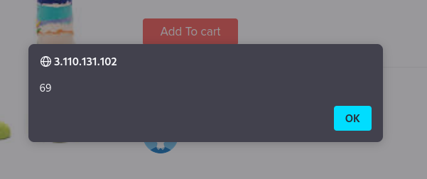
Proof of Concept (PoC)
Now, as it is vulnerable to XSS, an hacker can add various malicious scripts in it. Below is the script which added currently.
<script>alert(69)</script>

Slide 21
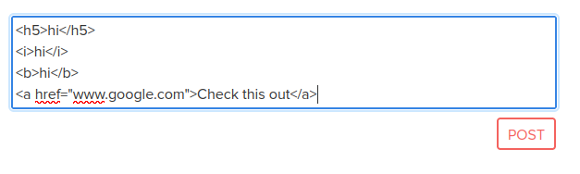

Proof of Concept (PoC)

Slide 22
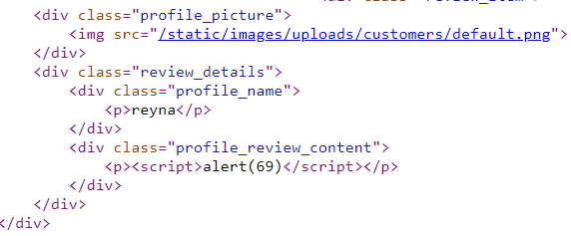
Business Impact - High
Redirect page to phishing sites, or fake login pages (leading to stealing your credentials)
Steal the users cookies, allowing them access to other web applications with authenticated sessions
Insert links to remotely hosted client side exploits within a html body; with the goal of installing malware on the system (key loggers, remote access tools)
Access virtual camera and
Corrupt motherboard of your system.

Slide 23
Recommendation
escape hatches that frameworks use to directly manipulate the DOM
Sanitize all user input and block characters you do not want.
Convert special HTML characters like ‘ “ < > into HTML entities &quot; %22 &lt; &gt;
before printing them on the website.

Slide 24
References
https://cheatsheetseries.owasp.org/cheatsheets/Cross_Site_Scripting_Prevention_Cheat_Sheet.html
https://owasp.org/www-community/attacks/xss/

Slide 25
4. Insecure Direct Object Reference (IDOR)
Insecure Direct Object Reference (Critical) | Below mentioned URL is vulnerable to Insecure Direct Object Reference. Affected URL : http://43.204.30.166/orders/orders.php?customer=16(all ID) Affected Parameters : customer (GET parameter)

Slide 26
4. Insecure Direct Object Reference (IDOR)
Insecure Direct Object Reference (Critical) | Below mentioned are some other URLs which are vulnerable to Insecure Direct Object Reference. Affected URL : http://43.204.30.166/profile/16/edit/ (all ID) http://43.204.30.166/forum/index.php?u=/user/profile/1 Affected Parameters : /profile/ (GET parameter) u=/user/profile (GET parameter)

Slide 27
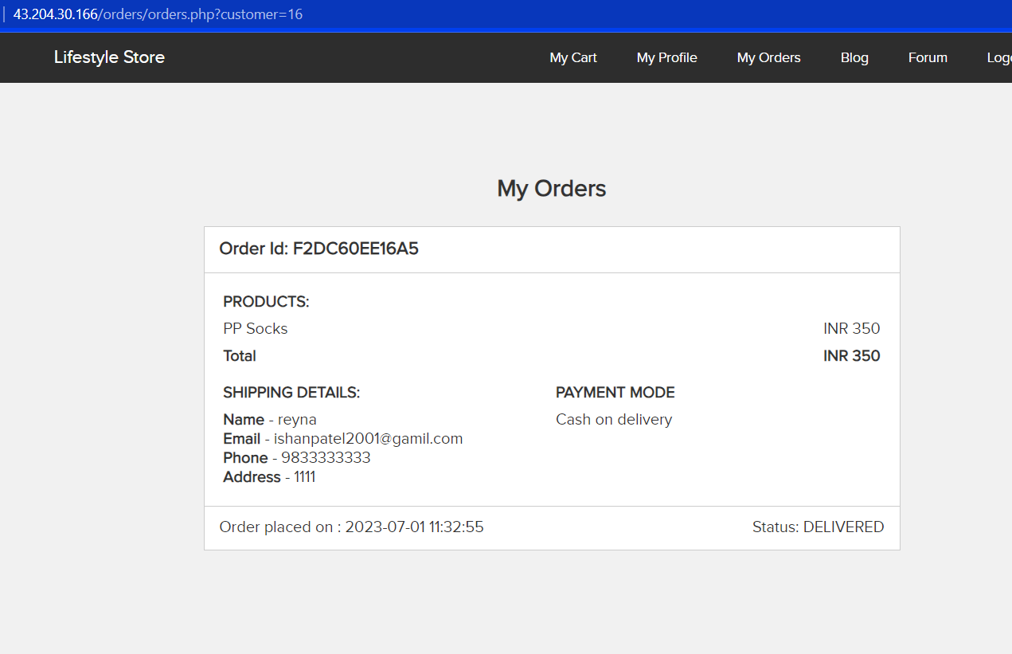
Observation
First, login to your account then go to the my orders section. Here you can see in the url the customer ID. http://43.204.30.166/orders/orders.php?customer=16
The receipt gives important details about the customer like address, phone number etc.

Slide 28
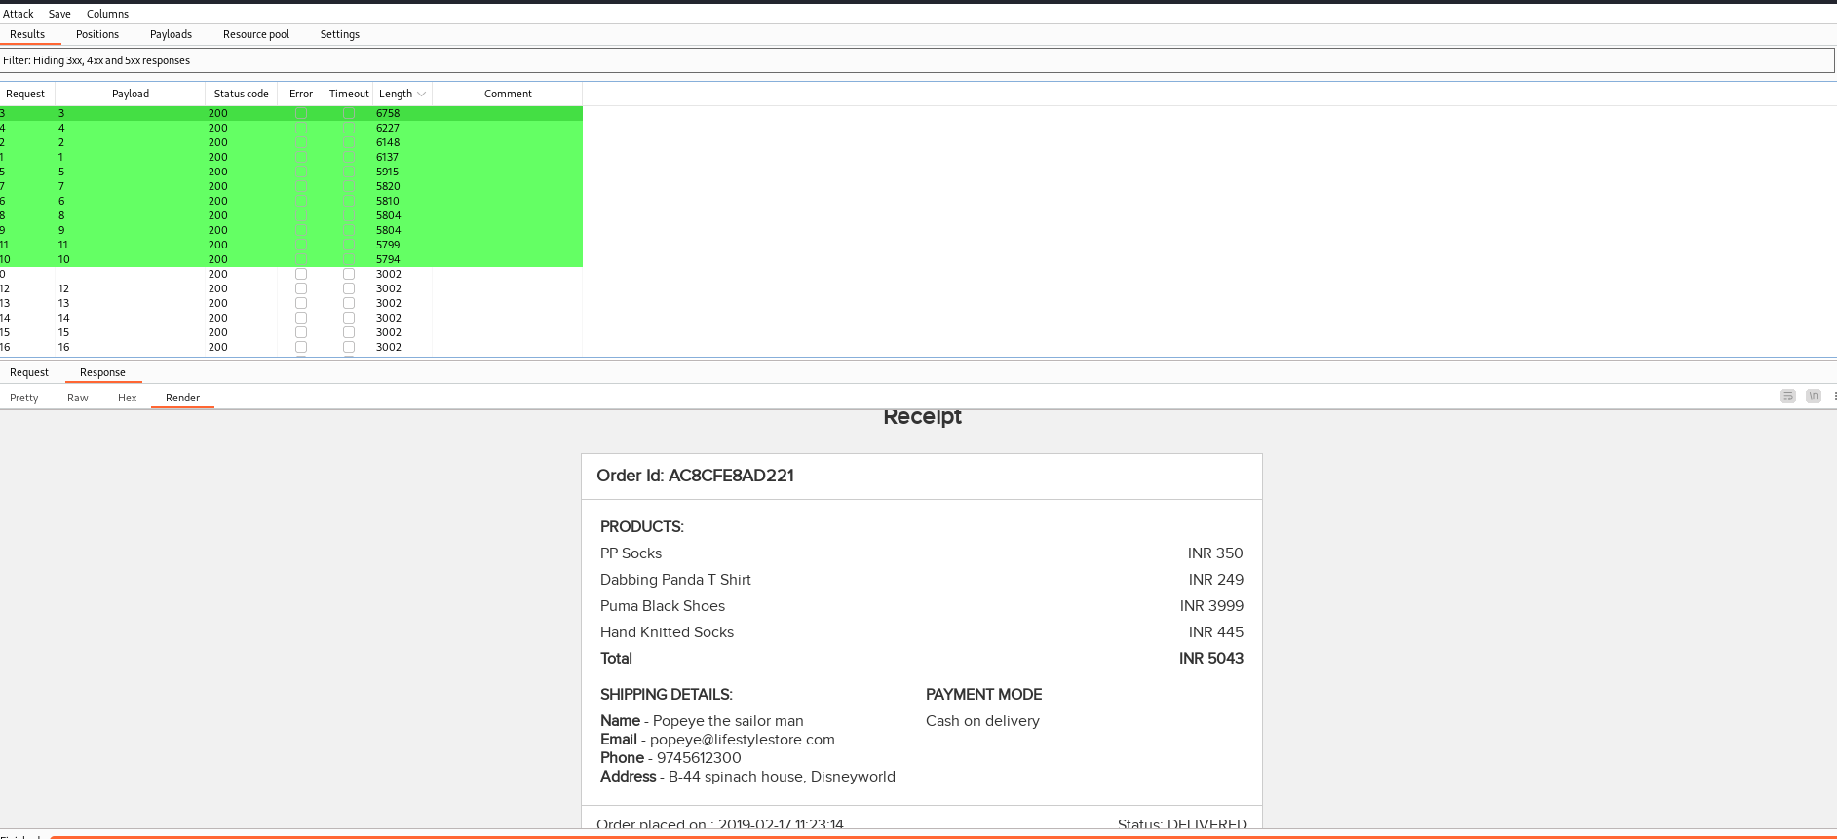
Proof of Concept (PoC)
Now, we will intercept the request and brute force the order_ID. From this we will get the details of other users.

Slide 29
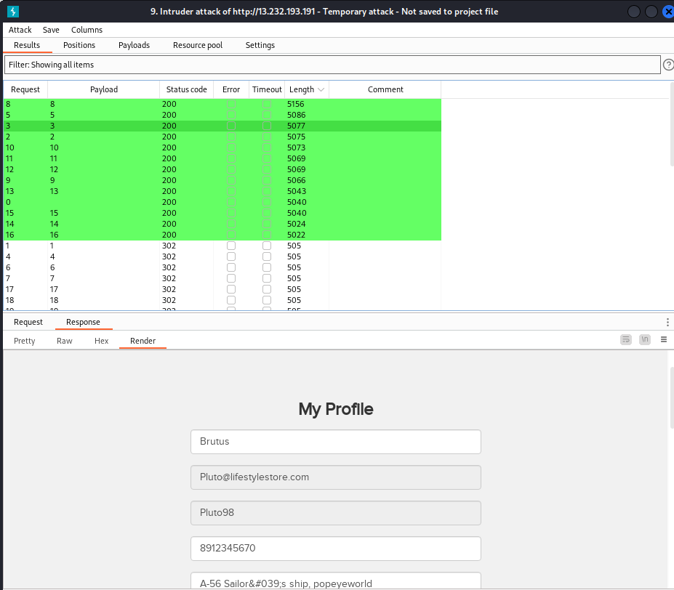
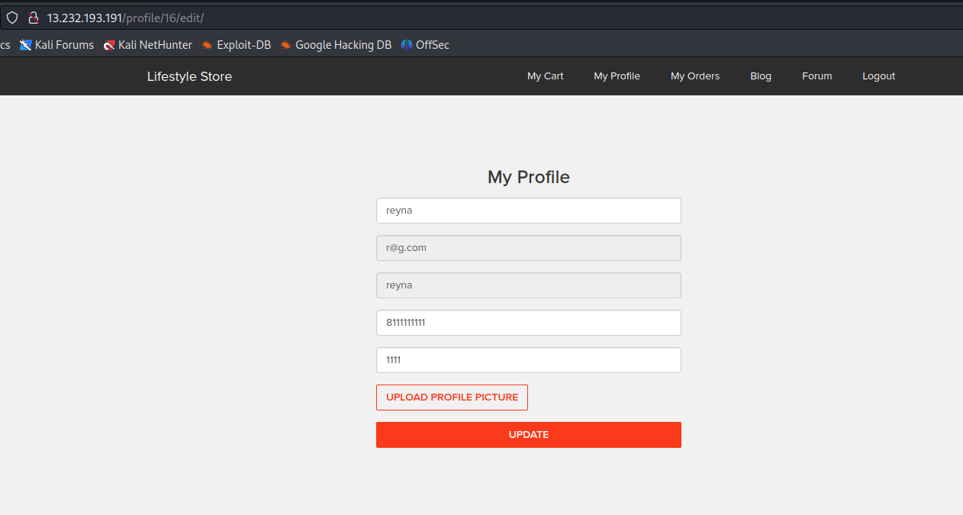
Proof of Concept (PoC)
In the edit profile section (shopping website), we can brute force the ID to view other user’s details.

Slide 30
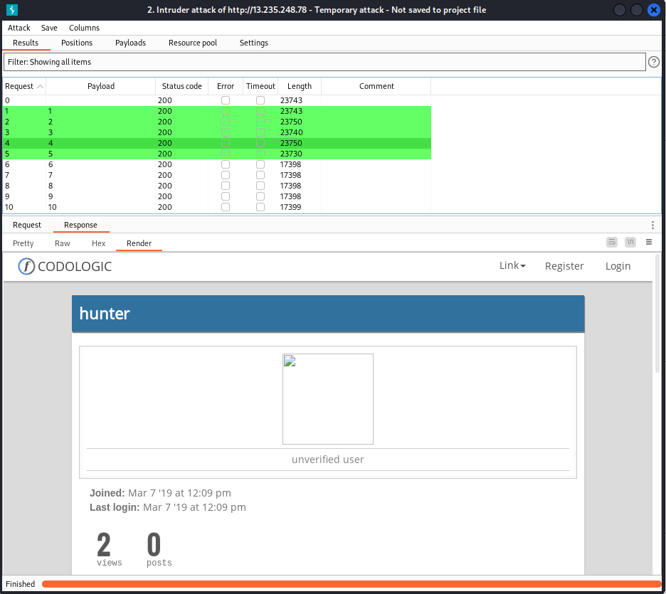
Proof of Concept (PoC)
In forum the view profile section can be brute force to view other users.

Slide 31
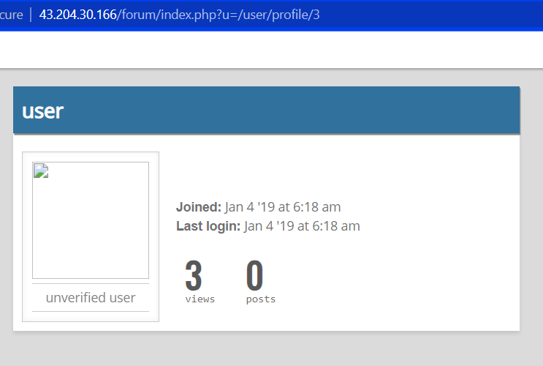
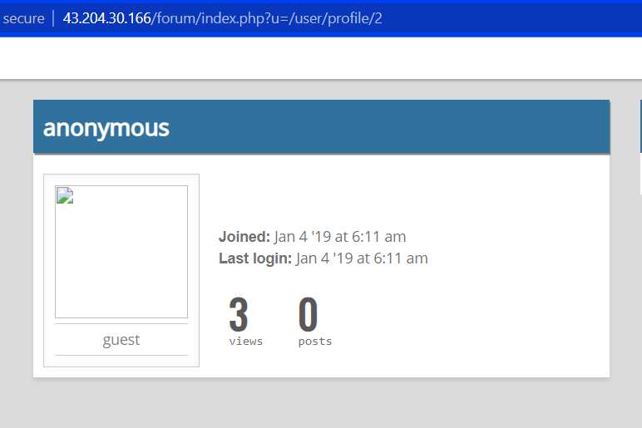
Proof of Concept (PoC)

Slide 32
Business Impact – Very High
Unauthorized access to sensitive data – Object references often include database IDs, which attackers can access to expose sensitive information about the application/users. The unauthorized user can also use database entries to prepare malicious SQL payloads for further attacks.
Object manipulation – With access to internal references, attackers gain direct access to the data and state of the application. Attackers can then manipulate the exposed objects to modify data, access hidden functions, or further escalate privileges.
Direct file access – Malicious users can combine IDOR attacks with directory transversal attack techniques to manipulate the host’s file system. This grants them the ability to upload/download files freely and manipulate content accessed by other users.

Slide 33
Recommendation
Using a hash enables the following properties:
Allows the absence of a mapping table—-real ID vs front-end ID—-in user session or application level caches.
Makes creation of the collection of enumeration values more difficult to achieve because, even if an attacker guesses the hash algorithm from the ID size, he cannot reproduce value, thanks to the salt.

Slide 34
References
https://crashtest-security.com/insecure-direct-object-reference-idor/
https://www.geeksforgeeks.org/insecure-direct-object-reference-idor-vulnerability/
https://en.wikipedia.org/wiki/Insecure_direct_object_reference
https://cheatsheetseries.owasp.org/cheatsheets/Insecure_Direct_Object_Reference_Prevention_Cheat_Sheet.html

Slide 35
5. Rate Limiting Flaw
Account takeover using OTP Bypass (Critical) | Below given login page uses otp to reset password which can be bypassed using brute force. Affected URL : http://43.204.30.166/login/admin.php Affected Parameters : OTP (POST parameter)

Slide 36
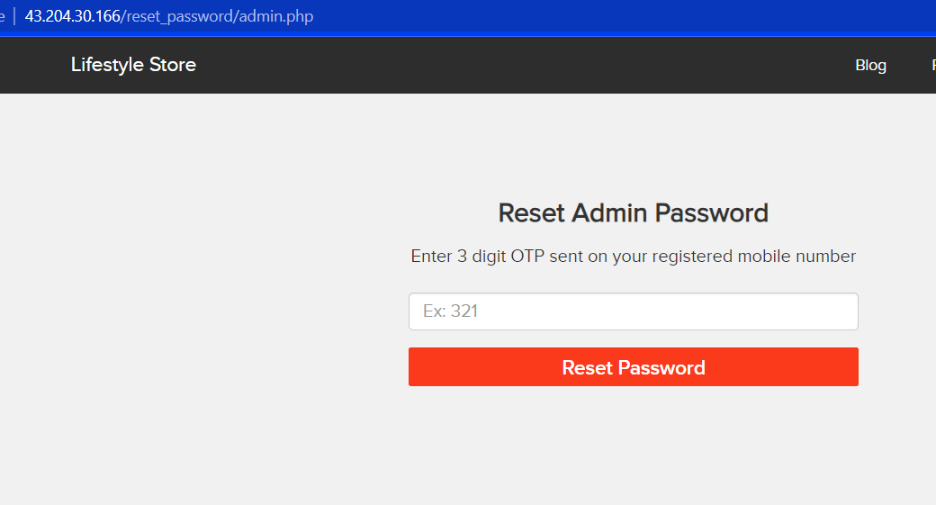
Observation
First of all navigate to the admin login page. Here you will find a forgot password option below the password section. When you will click on the link, you will be redirected to this page.
http://43.204.30.166/reset_password/admin.php

Slide 37
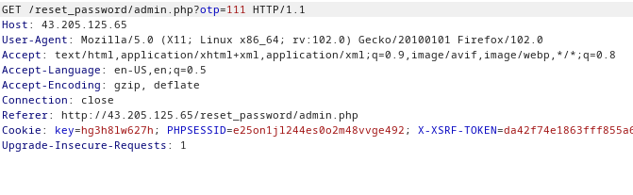
Observation
Now a 3-digit otp will be sent to admin’s registered phone number. (100-999). We can easily brute force this 3 digit otp by intercepting the request using burpsuite.

Slide 38
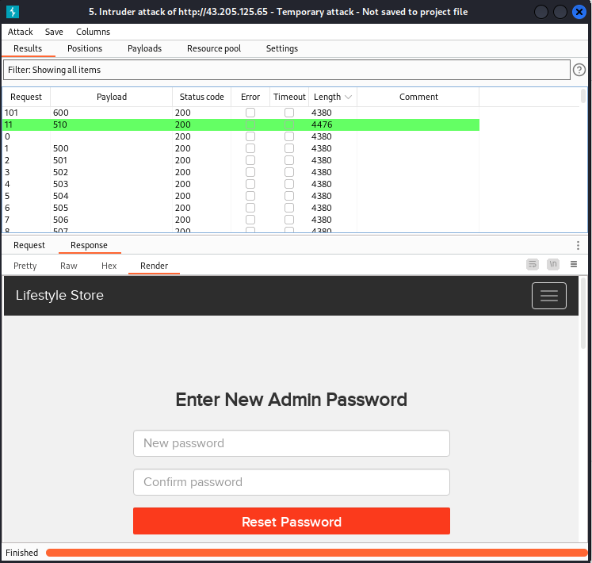
Proof of Concept (PoC)
We shoot the request with all possible combinations of 3 Digit OTPs and upon a successful hit, we get a response containing user details(i.e. the correct OTP). We can use this OTP to reset admin password and then use the new admin password to login as administrator.
In this session we found the otp using brute force which is 510.

Slide 39
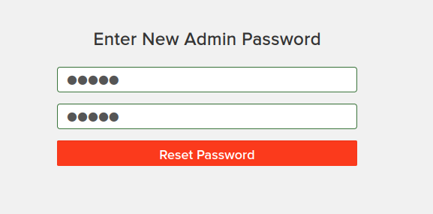
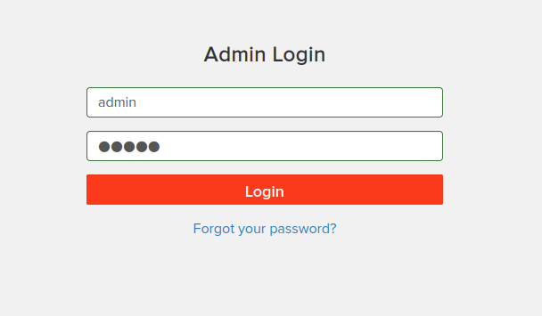
Proof of Concept (PoC)
Now, we can easily change the password for admin panel. The username of admin panel was default username which is admin.

Slide 40
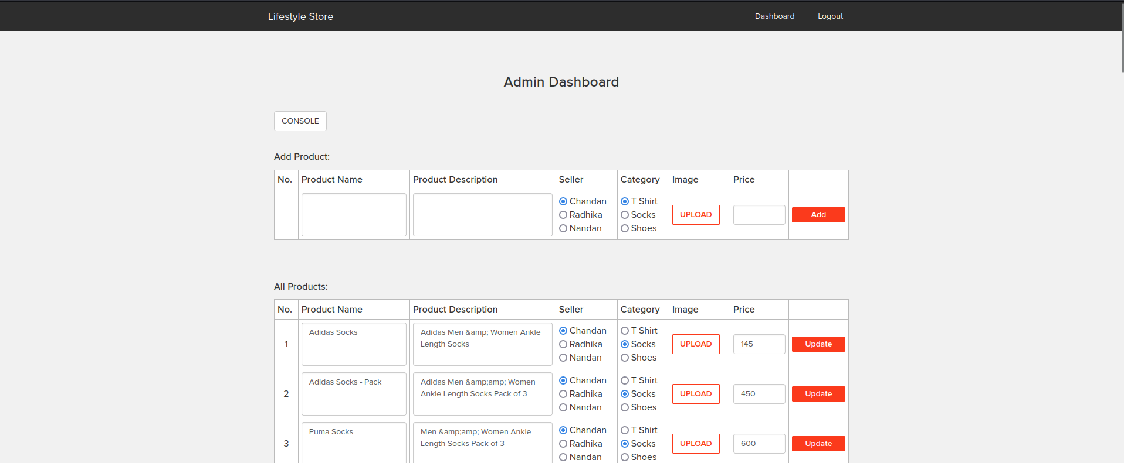
Proof of Concept (PoC)
Now, we can access the admin panel.

Slide 41
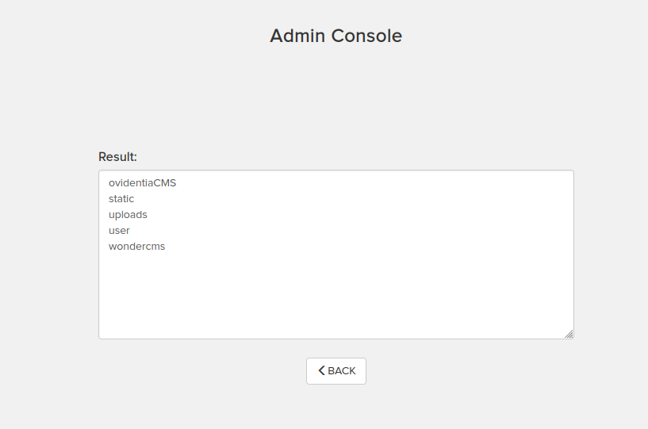
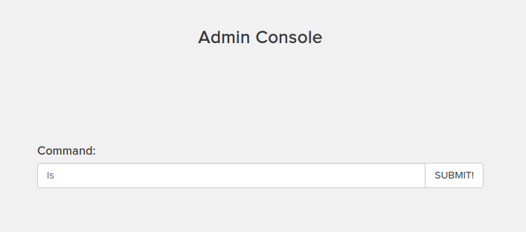
Proof of Concept (PoC)
Using console in admin dashboard, we can see all the files present in the database.

Slide 42
Business Impact – Very High
Let’s take an OTP situation. Now suppose, the length of otp is 3 digits and an attacker is guessing the otp for successful transaction theft. If no rate limiting is implemented in the web application, the hacker can manually type 000-999 values on otp to check which one is correct. This method is a little bit cumbersome, so the hacker can use a burp suite tool to do the same job in less time. Hence, after 30min, the otp gets unlocked and the attack is successful.
Once the attacker logs in as admin, then he can carry out actions on behalf of the victim(admin) which could lead to serious financial loss to him/her, like he can change the name, picture and even price of the products.

Slide 43
Recommendation
Monitoring API activity against your rate limit.
Catching errors caused by rate limiting.
Reducing the number of requests.
Extra precautions are taken with login, otp, vouchers etc.
Implement anti-bot measures such as ReCAPTCHA after multiple incorrect attempts.
OTP should expire after certain amount of time like 2-5 minutes.
OTP should be at least 6 digit and alphanumeric for more security.

Slide 44
References
https://www.geeksforgeeks.org/no-rate-limiting-flaw-in-cyber-security/
https://crashtest-security.com/owasp-api4-2019/

Slide 45
6. Insecure File Uploads
Insecure File Upload (Critical) | Below given URL is vulnerable to Insecure file Uploads. Affected URL : http://43.204.30.166/wondercms/ File Uploaded : Backdoor shell (hack.php)

Slide 46
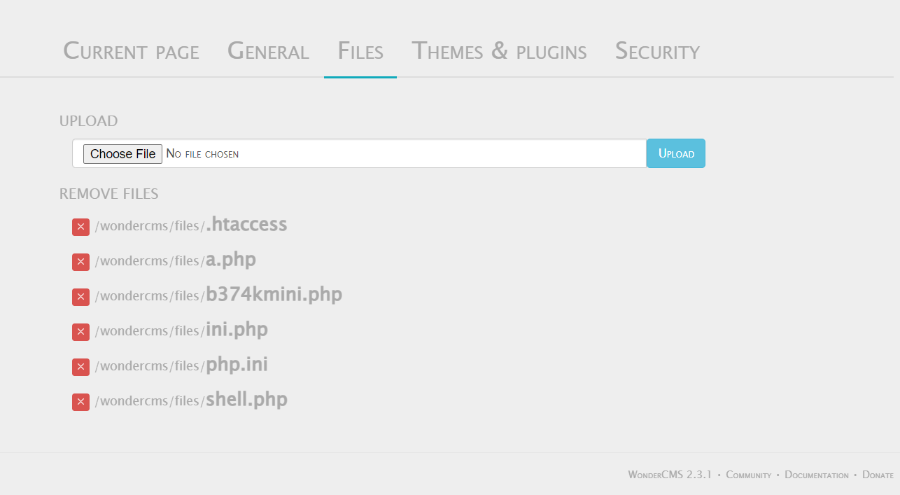
Observation
Go to the Blog section. Then login the admin panel (password given - admin).
Then go the settings and you will find the file upload section.

Slide 47
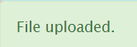
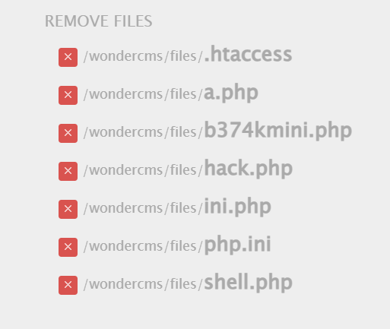
Observation
Now, lets try uploading our own shell (hack.php)
Looks like the shell is uploaded.

Slide 48
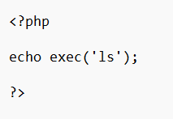
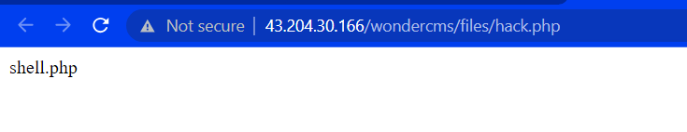
Proof of Concept (PoC)
Here is the shell hack.php
The shell got executed successfully.

Slide 49
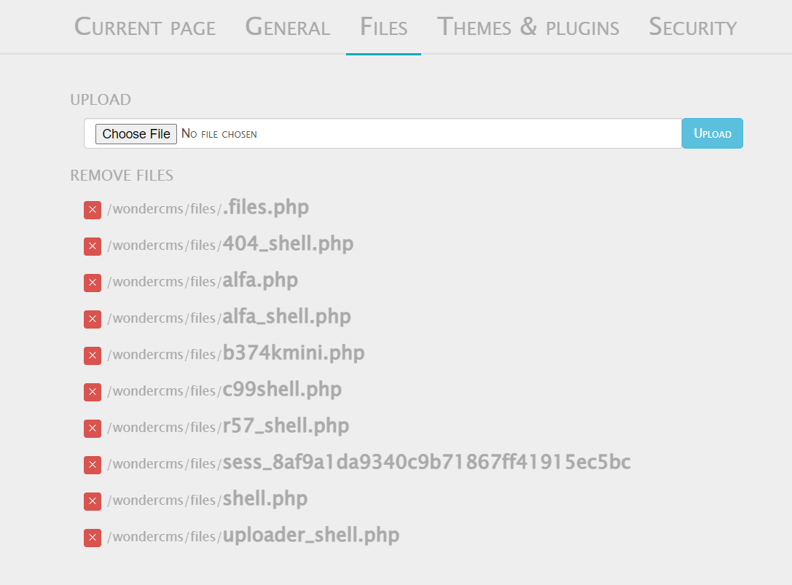
Proof of Concept (PoC)
Here are some other shells which are way more dangerous.

Slide 50
Business Impact – Extremely High
Being easy to execute and potentially exploited for various malicious activities, a file upload vulnerability is a common target of hackers. Impacts of a file upload attack include:
Cross-site content hijacking – Relates to vulnerable server instances where an attacker can substitute legitimate web pages with their content
Phishing attacks – Hackers can trick users with malicious scripts to gain access to sensitive data
Denial-of-Service – If the application fails to validate the number and size of uploaded files, hackers can fill up the disk storage, overloading the server to work on client requests
Remote code execution – Attackers leverage file upload commands to upload a web shell that allows them to execute arbitrary commands on the application server.

Slide 51
Recommendation
Whitelisting file types – Implement an allow-list that enforces the usability of only those file extensions that are approved to be used by the application.
File name restrictions – Once a file has been uploaded, remove all potentially dangerous characters, including unicode characters and special characters, to prevent injection attacks. Changing the uploaded file’s name is also recommended to prevent directory path exploits.
File upload validation – When validating file uploads, use trusted validation frameworks that address all potential gaps that attackers could exploit
File size restrictions – Enforce a file size limit and a maximum number of files that can be uploaded to keep attackers from flooding file storage.

Slide 52
References
https://crashtest-security.com/file-upload-attack/
https://owasp.org/www-community/vulnerabilities/Unrestricted_File_Upload

Slide 53
7. Client Side Bypass Filter
Client Side Bypass Filter (Moderate) | Below given URL is vulnerable to Client Side Bypass Filter. Affected URL : http://43.204.30.166/profile/16/edit/ http://43.204.30.166/forum/index.php?u=/user/profile/5/edit

Slide 54
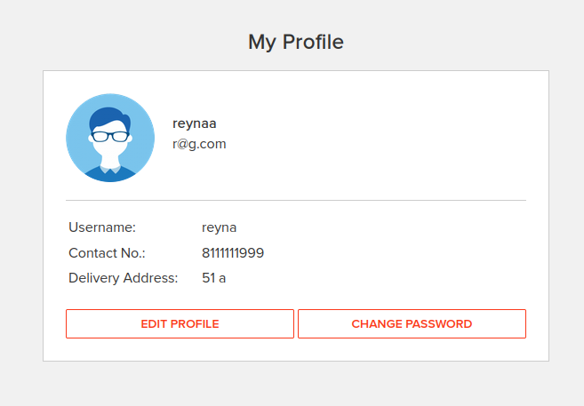
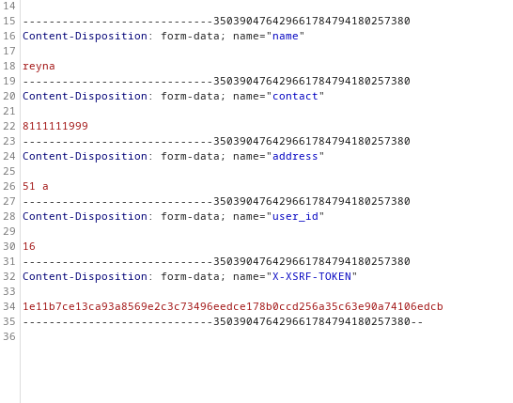
Observation
First Login in your account. Go to my profile section. There you will find and edit profile section.
My original number is 8111111999. Now we will change the number by intercepting the request using burpsuite.

Slide 55
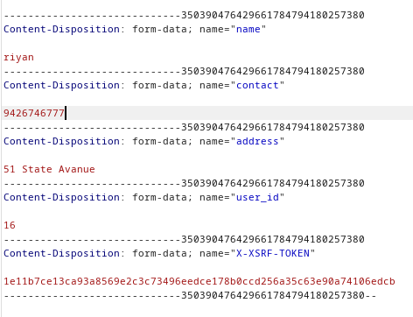
Observation
Now we will change this original number with a random number. (Tampering data)
We will also change the name and address.

Slide 56
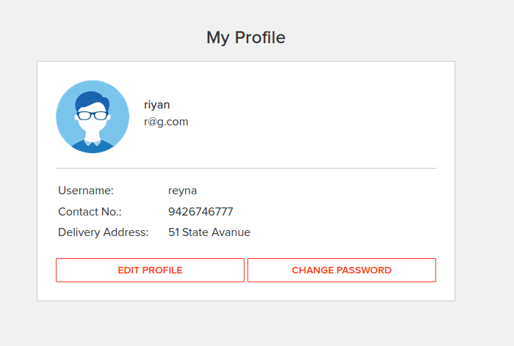
Proof of Concept (PoC)
The information is successfully updated.

Slide 57
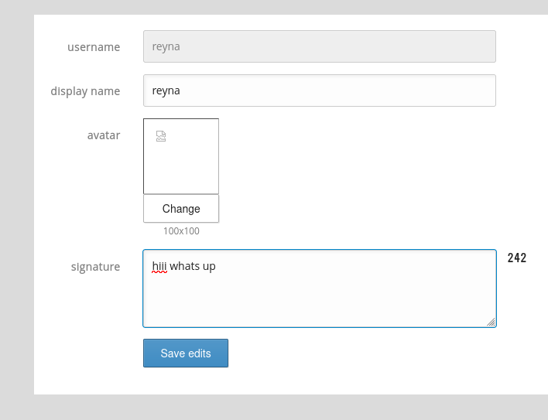
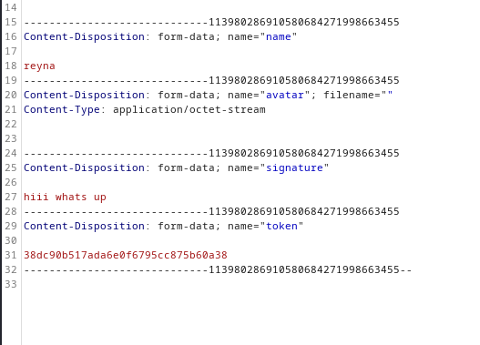
Observation
In the forum section, go to the edit profile section.

Slide 58
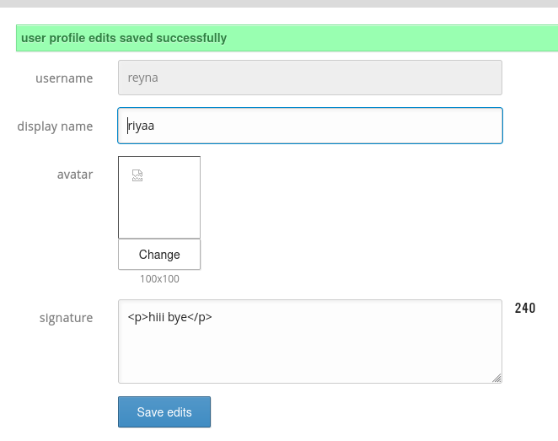
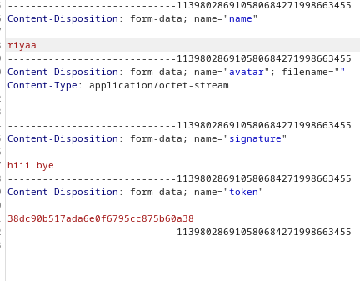
Proof of Concept (PoC)

Slide 59
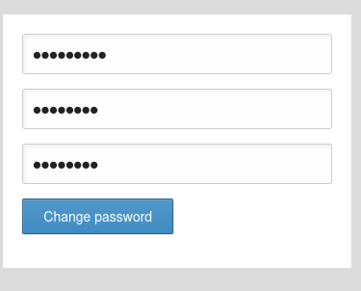
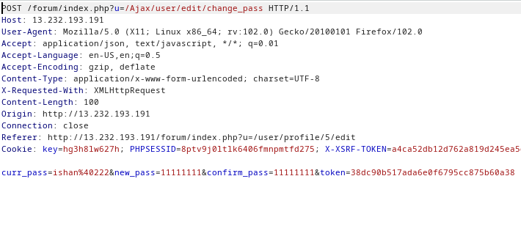
Observation
Along with altering the personal information, an attacker can also alter the change password request.

Slide 60
Proof of Concept (PoC)

Slide 61
Business Impact - High
Wrong Information Conveyed
Negative customer reviews

Slide 62
Recommendation
Implement all critical checks on server side code only.
Client-side checks must be treated as decorative only.
All business logic must be implemented and checked on the server code. This includes user input, the flow of applications and even the URL/Modules a user is supposed to access or not.

Slide 63
References
https://portswigger.net/support/using-burp-to-bypass-client-side-javascript-validation

Slide 64
8. Components with known vulnerability
Components with known vulnerability (Critical) | Below given URL is vulnerable to known vulnerability available on internet . Affected URL : http://43.204.30.166/wondercms/ http://43.204.30.166/forum/ PHP Version

Slide 65
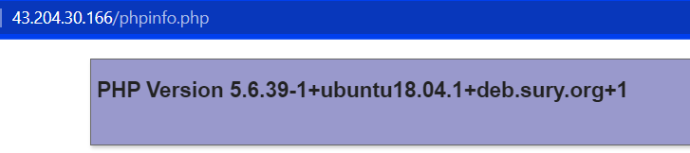
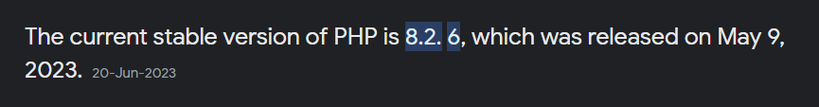
Observation
The PHP version (5.6.39) in shopping website is older one. (Outdated)
The latest PHP version(8.2.6) is given below.

Slide 66


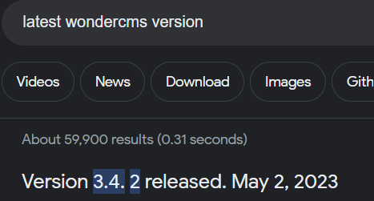
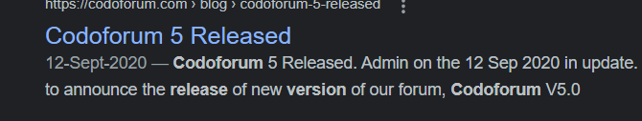
Observation
In the blog section, wonderCMS is used. This also running on an older version. Same goes with codoforum section.
Latest version of wonderCMS and codoforum.
2.5.1

Slide 67
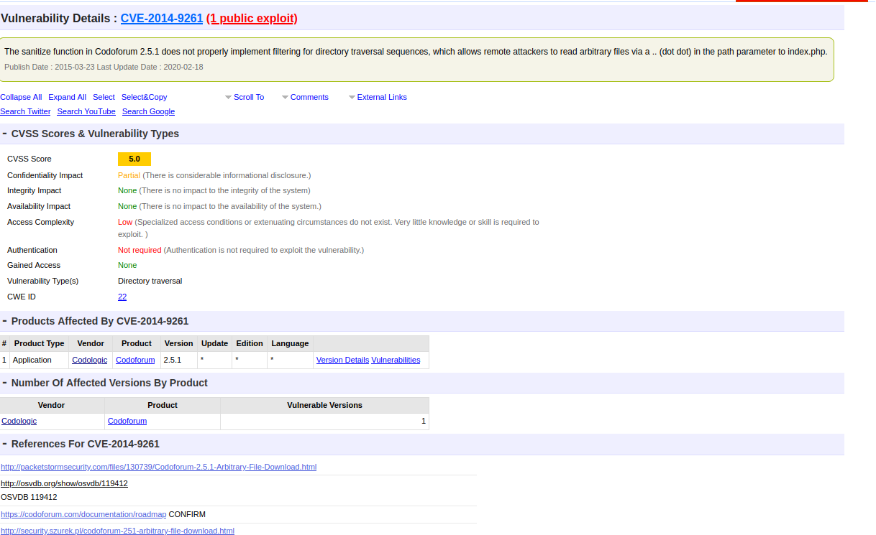
Proof of Concept (PoC) - CodoForum
An attacker can search various vulnerability available on the internet. (Public Exploits)

Slide 68
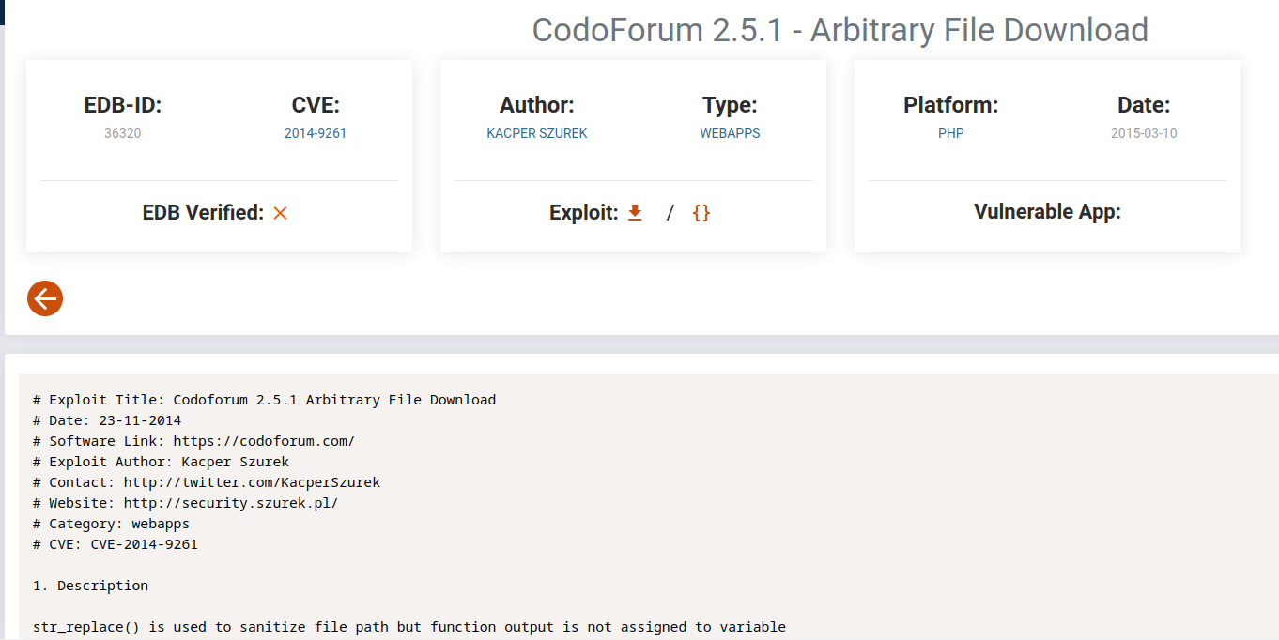
Proof of Concept (PoC) - Codoforum

Slide 69
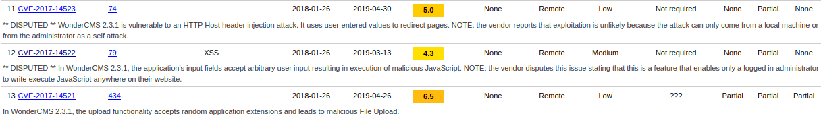
Proof of Concept (PoC) - WonderCMS

Slide 70
Business Impact – Extremely High
Anyone can perform any attacks (available) as all the exploits are available publicly .
It can cause severe damage to the website
He may be able to upload backdoor shells
He will easily deface your website

Slide 71
Recommendation
Hide all the version, banners of the software being used.
Update to the latest php version.
Check for newer version weekly.

Slide 72
References
https://www.cvedetails.com/cve/CVE-2017-14522/
https://www.exploit-db.com/exploits/36320
https://www.cvedetails.com/cve/CVE-2014-9261/

Slide 73
9. Default Admin Password
Default Admin Password (Critical) | Below given URL has default admin password. Affected URL : http://43.204.30.166/ovidentiaCMS/index.php?tg=login&cmd=authform&msg=Connexion&err=&restricted=1 Component name : Ovidentia CMS

Slide 74
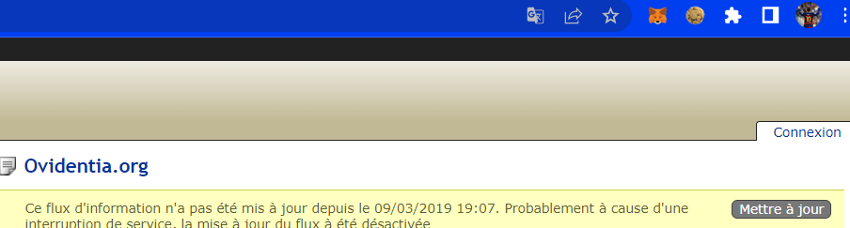
Observation
First we need to go to ovidentia cms using http://43.204.30.166/ovidentiaCMS/ . Then you will find an option called connexion at top right conner.

Slide 75

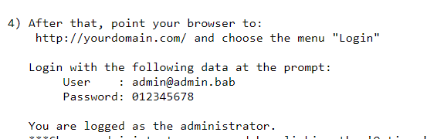
Observation
When you click on that section, you will be redirected to the admin login page.
While searching for default admin password for ovidentaiCMS, we found this –

Slide 76

Proof of Concept (PoC)
Now by giving the username and password we have, we will get the admin access.

Slide 77
Business Impact – Extremely High
When not changed, default credentials make an organization more vulnerable to potential cyberattacks. Attackers can easily obtain these standard login details, allowing them access to the devices on your network – usually with admin rights – and leaving them open to takeover.

Slide 78
Recommendation
Two- Factor Authentication for sensitive data should be added with strong passwords.
Hide the admin login page.
Remove all the default passwords and add your own password which should be very strong. It must contain a special character, at least one lowercase letter, at least one uppercase letter, and a number and it must be greater than or equal to 8 digits for maximum security.

Slide 79
References
https://www.cybonet.com/post/the-danger-of-default-passwords
http://chantal.jeannin.free.fr/install/install.txt

Slide 80
10. Descriptive Error Messages
Descriptive Error Messages (Low) | Below given URL is vulnerable to descriptive error messages. Affected URL : http://43.204.30.166/?includelang=lang/en.php Affected Parameter: lang=

Slide 81

Observation
On the main shopping page, you can see a language select section. Either English or French.
On clicking in the English option, you will be redirected to this url given below:
http://43.204.30.166/?includelang=lang/en.php

Slide 82

Proof of Concept (PoC)
Now adding various things in the url (fuzzing), we will get a descriptive error, from which an attacker can gain important information.
http://43.204.30.166/?includelang=[]lang/en.php

Slide 83
Business Impact - Low
It doesn’t affect the company much.
Hacker can know important information about the website architecture.

Slide 84
Recommendation
Developers should turn off this descriptive error messages before the web application

Slide 85
References
https://cheatsheetseries.owasp.org/cheatsheets/Error_Handling_Cheat_Sheet.html
https://deviq.com/practices/descriptive-error-messages/

Slide 86
11. Default Files Misconfiguration Flaw
Descriptive Error Messages (Low) | Below given URL is vulnerable to default files misconfiguration flaws. Affected URL : http://43.204.30.166/ Default Files and pages: Robots.txt Userlist.txt Phpinfo.php Server-status Composer.json

Slide 87

Proof of Concept (PoC)
Add server-status at the end of the url.
http://43.204.30.166/server-status

Slide 88

Proof of Concept (PoC)
Add phpinfo.php at the end of the url.
http://43.204.30.166/phpinfo.php

Slide 89

Proof of Concept (PoC)
Add robots.txt at the end of the url.
http://43.204.30.166/robots.txt

Slide 90

Proof of Concept (PoC)
Add userlist.txt at the end of the url.
http://43.204.30.166/userlist.txt

Slide 91

Proof of Concept (PoC)
Add composer.json at the end of the url.
http://43.204.30.166/composer.json

Slide 92
Business Impact - Low
It doesn’t affect the organization much but an attacker will be able to gain maximum information about the organization and later on he will use it against the org.

Slide 93
Recommendation
A minimal platform without any unnecessary features, components, documentation, and samples. Remove or do not install unused features and frameworks.
A task to review and update the configurations appropriate to all security notes, updates, and patches as part of the patch management process. Review cloud storage permissions (e.g., S3 bucket permissions).
A segmented application architecture provides effective and secure separation between components or tenants, with segmentation, containerization, or cloud security groups (ACLs).
Sending security directives to clients, e.g., Security Headers.
An automated process to verify the effectiveness of the configurations and settings in all environments.

Slide 94
References
https://owasp.org/Top10/A05_2021-Security_Misconfiguration/
https://www.indusface.com/blog/owasp-security-misconfiguration/

Slide 95
12. Remote File Inclusion
Remote File Inclusion (Critical) | Below given URL is vulnerable to remote file inclusion. Affected URL : http://3.110.31.57/?includelang=lang/en.php Affected parameter : lang=

Slide 96

Observation
First to the select language option and then select any one language. Now, you will be redirected to this url - http://3.110.31.57/?includelang=lang/en.php

Slide 97

Proof of Concept (PoC)
Now, an attacker can change the url from lang= (shell link).
http://3.110.31.57/?includelang=https://www.google.co.in/

Slide 98
Business Impact – Very High
Information theft
Compromised servers
Site takeover that allows for content modification.
Malicious File uploads

Slide 99
Recommendation
Never use arbitrary input data in a literal file include request
Use a filter to thoroughly scrub input parameters against possible file inclusions
Build a dynamic whitelist

Slide 100
References
https://www.imperva.com/learn/application-security/rfi-remote-file-inclusion/
https://www.esecurityplanet.com/endpoint/how-to-prevent-remote-file-inclusion-rfi-attacks/

Slide 101
13. Directory Listing
Directory Listing (Moderate) | Below given URL is vulnerable to poor directory listing. Affected URL : http://3.110.31.57/static/images/uploads/products/s2.jpeg(all product images) http://3.110.31.57/robots.txt

Slide 102

Observation
First go to any product. Then, right click on the image of the product and open it in a new tab. You will be find this url over there – http://3.110.31.57/static/images/uploads/products/s2.jpeg

Slide 103

Proof of Concept (PoC)
If you remove the particular product from the url (http://3.110.31.57/static/images/uploads/products/)

Slide 104

Observation
As we can see in the url the whole path of images uploaded. One can also find this path using this url - http://3.110.31.57/robots.txt

Slide 105

Proof of Concept (PoC)

Slide 106
Business Impact - High
Although this vulnerability does not have a direct impact to users or the server, though it can aid the attacker with information about the server and the users.
Also, an attacker can take important information like what all products are being sold by the sellers and can simply download the images, view them and can even use them against the users or the organization.

Slide 107
Recommendation
Change your server configuration file. A recommended configuration for the requested directory should be in the following format:
<Directory /{YOUR DIRECTORY}>
Options FollowSymLinks
</Directory>
Remove the Indexes option from configuration. Do not forget to remove MultiViews as well.
Configure the web server to disallow directory listing requests.
Ensure that the latest security patches have been applied to the web server and the current stable version of the software is in use.

Slide 108
References
https://www.invicti.com/web-vulnerability-scanner/vulnerabilities/directory-listing-apache/
https://www.socinvestigation.com/directory-listing/

Slide 109
14. Personal Identifiable Information Leakage
PII Leakage (Moderate) | Below given URL is vulnerable to personal identifiable information leakage. Affected URL : http://3.110.31.57/profile/16/edit/ Seller Information

Slide 110

Observation
On the main shopping page, visit any product- there you will find Seller Info.

Slide 111

Proof of Concept (PoC)
On clicking on seller info you will find name, rating, city, PAN number and email.

Slide 112
Observation
Login in your account- Go to your profile section, there you will find edit profile section (http://3.110.31.57/profile/16/edit/)

Slide 113
Proof of Concept (PoC)
Using brute force on profile ID – We can see profiles of other users and their personal information.

Slide 114


Proof of Concept (PoC)

Slide 115
Business Impact - High
Leaking personal information like pan card, physical address is very dangerous, as the hacker can use this information to hack any person socially.

Slide 116
Recommendation
Automatic USB encryption = Encrypt, manage and secure USB storage devices by safeguarding data in transit. Password-based, easy to use and very efficient.
USB & Peripheral port control = Define granular access rights for removable devices and peripheral ports and establish policies for users, computers and groups, maintaining productivity while enforcing device security.

Slide 117
References
https://www.endpointprotector.com/lp/data-leakage-prevention
https://www.zerofox.com/blog/damaging-consequences-data-leakage/
https://www.geeksforgeeks.org/personally-identifiable-information-leakage-vulnerability/

Slide 118
15. Open Redirection
Open Redirection (Severe) | Below given URL is vulnerable to open redirection. Affected URL : http://3.110.31.57/redirect.php?url=www.chandanstore.com Affected parameter : url=

Slide 119

Observation
Login to your account and go to any product.
You will find the brand website over there.

Slide 120

Observation
When you click on the brand website, you will be redirected to this url - http://3.110.31.57/redirect.php?url=www.chandanstore.com

Slide 121

Proof of Concept (PoC)
Now, instead of original brand website url, change it with some other url.
In our case we have taken https://www.google.co.in

Slide 122
Business Impact - High
The hacker can redirect your page to a malicious page or some other phishing sites.
An attacker can construct a URL within the application that causes a redirection to an arbitrary external domain. This behavior can be leveraged to facilitate phishing attacks against users of the application.

Slide 123
Recommendation
Do not use forwards and redirects.
Do not allow URLs as user input for a destination.
If absolutely necessary to accept a URL from users, ask the users to provide a short name, token, or ID that is mapped server-side to the full target URL. This method provides a high level of protection against attacks that tamper with URLs. However, you must be careful not to introduce an enumeration vulnerability that allows users to cycle through IDs and find all possible redirect targets.

Slide 124
References
https://brightsec.com/blog/open-redirect-vulnerabilities/
https://portswigger.net/kb/issues/00500100_open-redirection-reflected

Slide 125
16. Burteforce Exploitation
Bruteforce Exploitation (Severe) | Below given URL is vulnerable to bruteforce exploitation using which we can exploit OTPs. Affected URL : http://3.110.31.57/cart/cart.php

Slide 126

Observation
Login to your account then go to my cart section.
Here you can see the products which you have added in the cart.
You can also find apply coupon for discount.

Slide 127


Proof of Concept (PoC)
We can see that there is a example of a coupon code
Using this we can bruteforce the coupon code.

Slide 128
Proof of Concept (PoC)
Coupon code applied successfully.

Slide 129
Business Impact – Severe
Hacker can easily use bruteforce every time to order sometime at a very cheap price. As every time the hacker will bruteforce the coupon code which applies discount.
This can make huge impact on the company.

Slide 130
Recommendation
Coupon codes should have limited number of uses and should be regenerated after sometime.
Coupon code should be random alpha-numeric characters.

Slide 131
References
https://github.com/SamDecrock/discount-code-bruteforcer
https://www.couponxoo.com/brute-force-attack-coupon-code

Slide 132
17. Command Execution Vulnerability
Command Execution Vulnerability (Critical) | Below given URL is vulnerable to command execution vulnerability. Affected URL : http://3.110.31.57/wondercms/files/b374kmini.php http://3.110.31.57/admin31/console.php

Slide 133


Observation
First go to the blog section, where on the main page you can easily find admin login (with password)
After logging in, go to settings, there you will find the files option.

Slide 134
Observation
In the files section, hacker can upload any malicious script or shell to gain complete access.

Slide 135

Proof of Concept (PoC)
If you click on b374kmin.php (It’s a malicious shell), you can get complete information of the website including admin login password, database credentials etc.

Slide 136

Proof of Concept (PoC)
Input – ls, whoami

Slide 137

Proof of Concept (PoC)
Other valuable information.

Slide 138

Proof of Concept (PoC)
Other login credentials.

Slide 139
Observation
On the main website, login into admin account (force browsing). There you will find a console option.

Slide 140
Proof of Concept (PoC)
Shopping website admin console.

Slide 141
Business Impact – Extremely High
Including complete system takeover, an overloaded file system or database.
Forwarding attacks to back-end systems.
Client-side attacks, or simple defacement.

Slide 142
Recommendation
Hide all files in the Upload Screen.
Delete all php shells.

Slide 143
References
https://owasp.org/www-community/attacks/Command_Injection
https://github.com/tennc/webshell/blob/master/php/b374k/mini_b374k

Slide 144
18. Forced Browsing
Force Browsing (Severe) | Below given URL is vulnerable to forced browsing. Affected URL : http://3.110.31.57/ Forced URLs: http://3.110.31.57/admin31/dashboard.php http://3.110.31.57/admin31/console.php

Slide 145
Observation
First of all, login to your customer account on the main shopping website.
Then in the new tab open this urls (which gives access to admin panel)
http://3.110.31.57/admin31/dashboard.php
http://3.110.31.57/admin31/console.php
(You got to know about this url in rate limiting flaw.)

Slide 146

Proof of Concept (PoC)
Forcefully admin dashboard access. I have also attached a video for better understanding.

Slide 147

Proof of Concept (PoC)
Forcefully access to admin console.

Slide 148
Business Impact – Very High
An attacker can easily get the admin privileges through this vulnerability.
Hacker can run malicious commands on console to get valuable information.

Slide 149
Recommendation
A web application firewall (WAF) is the best API security
satisfactory access control and forcing an application URL space allowlist.
Permitting express admittance to safe, permitted URLs is important for making an allowlist. Any solicitation outside of this URL district will be dismissed naturally, as these URLs are viewed as a fundamental component of the functioning application.

Slide 150
References
https://www.wallarm.com/what/forced-browsing-attack
https://owasp.org/www-community/attacks/Forced_browsing

Slide 151
19. Seller Account Access
Seller Account Access (Critical) | Below given URL gives the username and password of seller’s accounts. Affected URL : http://3.110.31.57/userlist.txt

Slide 152

Observation
Using this url http://3.110.31.57/userlist.txt, we get this information.
(default files misconfiguration flaw)
We can easily guess this as usernames and passwords.

Slide 153

Observation
Now, go to the seller’s login page and try this usernames and passwords.

Slide 154

Proof of Concept (PoC)
Here you can see that we have successfully logged in in the account.

Slide 155
Business Impact – Very High
Attacker can access the seller dashboard and then can edit the product’s name, image, and even the price of the products he/she is selling, which in turn can harm the seller’s reputation and even the company might face losses for the same.

Slide 156
Recommendation
The developer should disable these confidential default pages which reveals the username and password of the sellers.

Slide 157
References
https://owasp.org/Top10/A05_2021-Security_Misconfiguration/
https://reciprocity.com/blog/security-misconfigurations-how-to-avoid-them/

Slide 158
20. Cross Site Request Forgery
Cross Site Request Forgery (Severe) | Below given URL is vulnerable to cross site request forgery. Affected URL : http://3.110.31.57/profile/change_password.php

Slide 159

Observation
Login as a customer and then go to my profile section, there you can find the change password button.
Lets see if we can forge this request or not.

Slide 160

Proof of Concept (PoC)
Lets make HTML login page. Change your password here and press on update button.

Slide 161


Proof of Concept (PoC)
Now try logging in with the new password. It will work.

Slide 162
Business Impact - Severe
Attacker can change the password by uploading phishing pages and take complete control of the user account and use it to plan further attacks on the company.
Attacker can confirm the order without consent of user which in turn can lead to a huge loss for the company.

Slide 163
Recommendation
For stateful software use the synchronizer token pattern
For stateless software use double submit cookies
Implement at least one mitigation from Defense in Depth Mitigations section
Consider implementing user interaction based protection for highly sensitive operations

Slide 164
References
https://cheatsheetseries.owasp.org/cheatsheets/Cross-Site_Request_Forgery_Prevention_Cheat_Sheet.html
https://owasp.org/www-community/attacks/csrf

Slide 165
THANK YOU
Contact Details Email – ishanpatel2001@gmail.com

